Slide 1
Brain Tumor Detection: Harnessing the Power of CNN EfficientNet B3
Author: Mawada Mohammed
University of Khartoum – FACULTY OF MEDICAL LABORATORY SCIENCE

Slide 2
Introduction
Brain tumors are a serious health concern, often requiring early and accurate diagnosis for effective treatment.
Traditional methods rely on manual examination of medical images, which can be time-consuming and prone to human error.
Our research explores the use of Convolutional Neural Networks (CNNs), specifically EfficientNet B3, for automated and accurate brain tumor detection.

Slide 3
EfficientNet B3: A Powerful Architecture
EfficientNet B3 is a state-of-the-art CNN architecture known for its high accuracy and efficiency.
It strategically balances network depth, width, and resolution to achieve optimal performance.
This makes it ideal for complex image classification tasks like brain tumor detection.

Slide 4
Methodology
1. Dataset: We curated a dataset of brain MRI images labeled as "Tumor" or "No Tumor".
2. Data Preprocessing: Images were resized and normalized to prepare them for the CNN.
3. Model Training: We trained EfficientNet B3 on the prepared dataset, optimizing for accuracy.
4. Model Evaluation: The trained model was rigorously evaluated on a separate test dataset to measure its performance.

Slide 5
Results: Impressive Performance
Training Performance
Loss: 2.2
Accuracy: 1 (100%)
Test Performance
Loss: 2.4
Accuracy: 0.94 (94%)

Slide 6
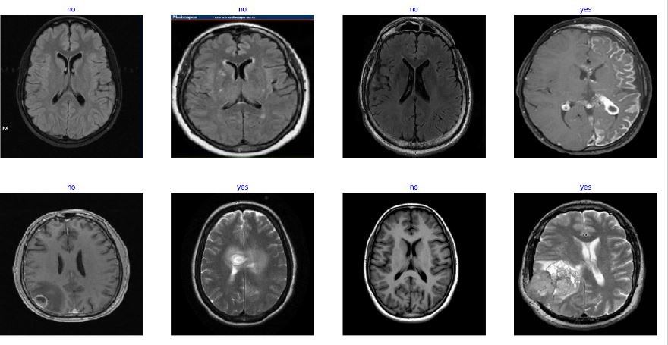
Visualization: Insights from the Model
This visual representation helps understand the model's strengths and potential areas for improvement.

Slide 7
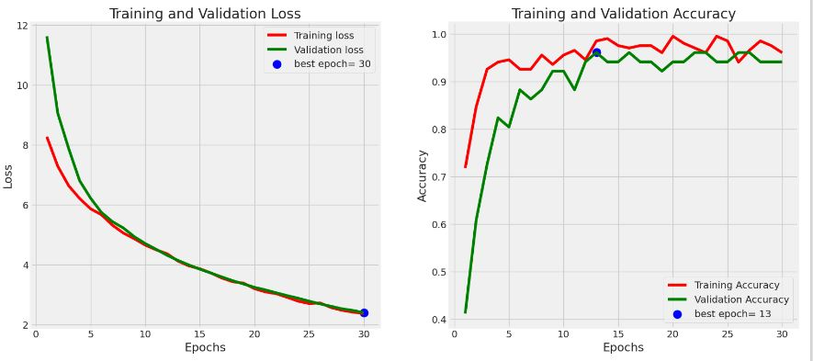

Slide 8
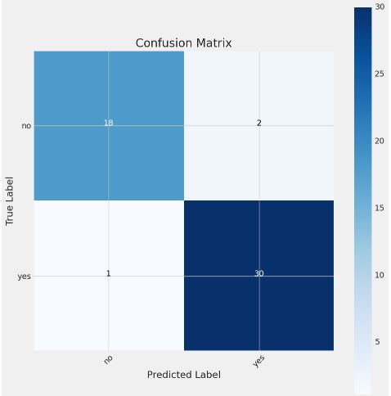

Slide 9
Discussion: Significance and Future Directions
High accuracy achieved on the test set demonstrates the potential of EfficientNet B3 for automated brain tumor detection.
This technology could assist medical professionals in making faster and more informed diagnoses, potentially leading to better patient outcomes.
Future work will focus on:
- Expanding the dataset size and diversity.
- Exploring other advanced CNN architectures.
- Developing a user-friendly interface for clinical use.

Slide 10
Conclusion
Our research highlights the significant potential of CNNs, particularly EfficientNet B3, for accurate brain tumor detection.
This technology holds promise for revolutionizing medical image analysis and improving healthcare delivery.

Slide 11

contact me on: mawadamhd12@gmail.com

